Slide 1
Section 4:
Preparing ALL Students for College

Slide 2

Section Four Objectives
Discuss college with students and families while honoring choice
Teach self-advocacy and other important skills for college
Advocate for inclusive opportunities to prepare students for future inclusion

Slide 3
Preparing Early
“Parents are quickly learning about the availability of college programs for their children with ID, and they are seeking admission to them at an unprecedented rate. As they do, they often ask us, “What can we do to increase the chance our child will be admitted?” Unfortunately, when they ask the question, it is often too late for them to do the kinds of things that will ready their child for college. The kinds of attitudes and activities that are most important should begin early in life and continue until the individual is ready to enter college.” - Western Carolina UP Program

Slide 4
Preparing Early
Discussions about postsecondary options
Person centered planning
Development of self advocacy
Spending time in inclusive settings
Visits to college campuses
For professional development credit, complete the Google Form, linked in the video description

Slide 5


Changing the Conversation

Slide 6
Your Impact
“Teachers’ expectations have a greater impact on a student becoming employed or going to college than will a student’s skills or disabilities” –Think College

Slide 7
To begin the conversation,
Routinely ask about post secondary goals and thoughts on college
Invite college grads to speak and share their stories
Take field trips to inclusive colleges

Slide 8
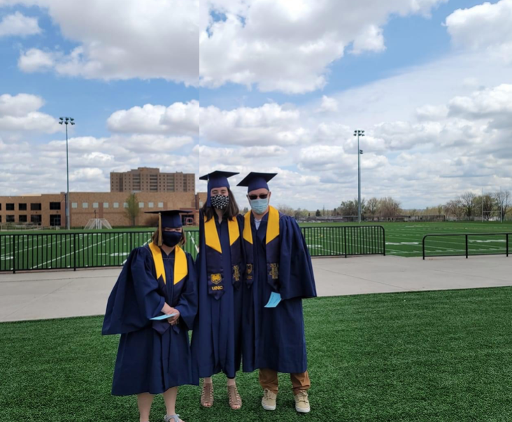
Is it realistic?
Presenting college as an option to all students
Informed choice

Slide 9
Person Centered Planning (PCP)

Slide 10
Resources for PCP
PATH
MAPS
Speak Up Colorado
Local organizations

Slide 11
Strategies to center the student:
Begin the IEP development early
Align IEP goals with long term post secondary goals
Talk to the student

Slide 12
Inclusion

Slide 13
Academic Inclusion

Slide 14
Elementary Strategies:
Encourage inclusion in general education classrooms as much as possible

Slide 15
Middle & High School Strategies:
Continue to advocate for students to take standard education classes within the general education setting
Develop academic interests
Explore assistive technology tools

Slide 16
Career Inclusion

Slide 17
College and Impact on Careers
135% increase in employability
28% decrease in food preparation industries
59% drop in cleaning and maintenance occupations

Slide 18
Career Goals & College
A clear career goal helps students to:
      Be informed about whether college is the right path for them
      Select a college that aligns with what they want to study

Slide 19
Types of Career Goals Students Bring to College
Vague goal, missing reasons contributing to the student’s interest
Specific goal, too specific to be achievable in Colorado
Career goal not in alignment with going to college
    Only wants social aspects
    Or, doesn’t know about the other types of careers college can help you to access

Slide 20
Elementary Strategies:
Read books about career exploration
Watch videos about different vocations
Take field trips to a variety of workplaces
Volunteer as a classroom at different locations
Invite guest speakers with disabilities to share about their jobs

Slide 21
Middle & High School Strategies:
Establish individual volunteer or internship opportunities
Routinely survey students about career interests and discuss the variety of positions within a field of interest
Collaborate with families to look for summer opportunities
Encourage participation in clubs that relate to the student’s field of interest
Connect to the Division of Vocational Rehabilitation

Slide 22
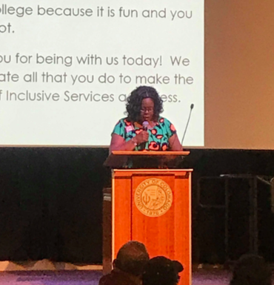
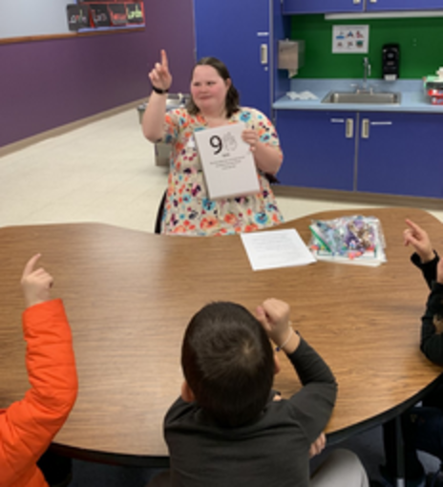
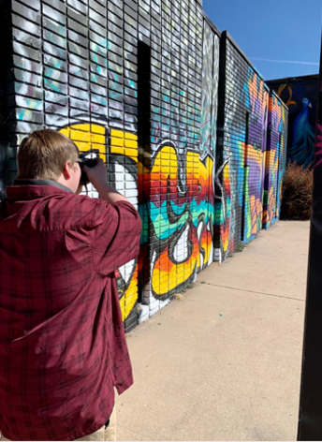

Slide 23
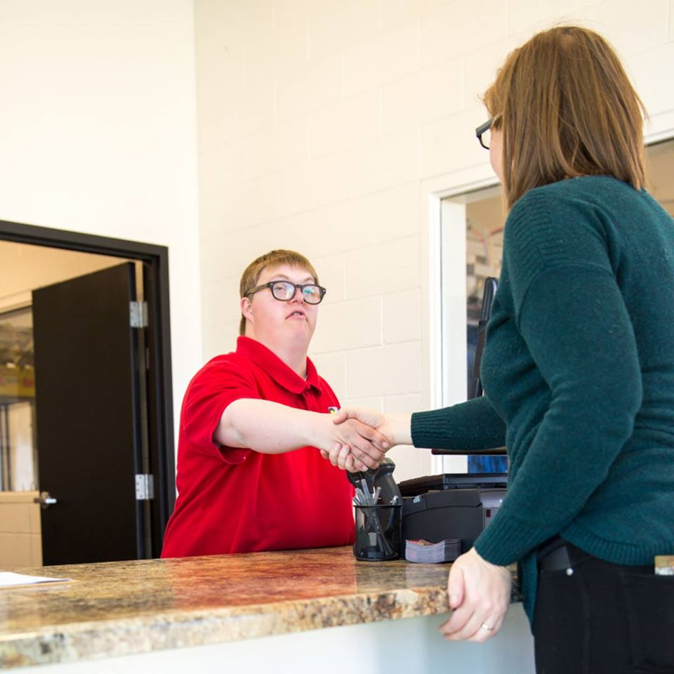

Slide 24
Social Skills Preparation

Slide 25
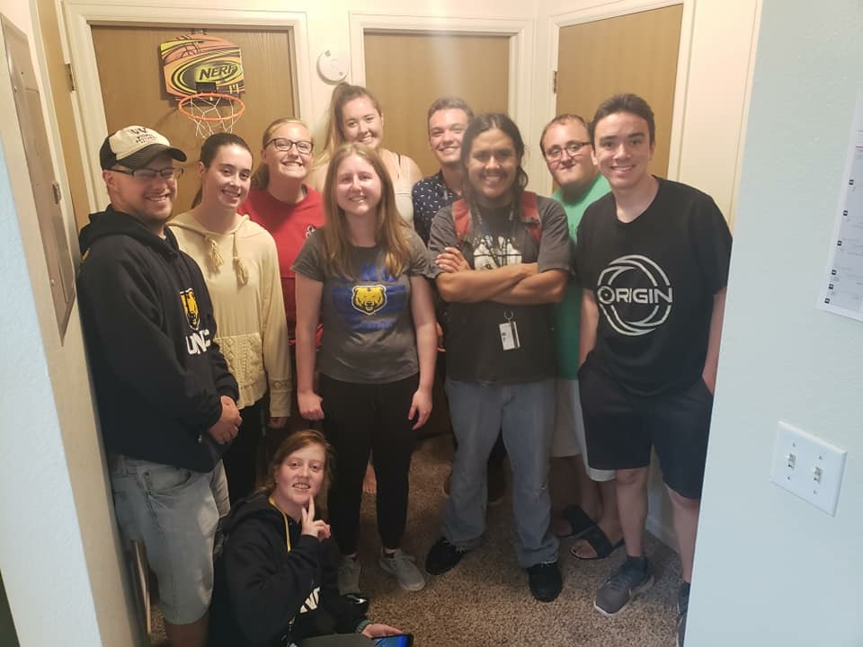

Slide 26
Elementary Strategies:
Encourage students to plan and invite friends to events
Work with students to identify who their friends are and what makes a good friend

Slide 27
Middle & High School Strategies:
Utilize peer mentors,
if resources allow
Practice texting, email, and using social media
Practice with students to identify, find, and register for events/activities of interest to them
Encourage involvement in extracurricular activities
and sports

Slide 28
Independence

Slide 29
See the supplemental resources page for links!
Independence

Slide 30
During the school day:
Respond to emails
Use a calendar and follow a schedule
Get lunch and snacks
Find classes

Slide 31
Responsibilities at home for students:
Wake up to an alarm
Work towards doing your own laundry
Pack your backpack and lunch
Use electronic reminders to be on time independently
Practice using public transportation
Develop a schedule tracking system
Money management
Learn to cook a few staple meals
Connect to your Community Centered Board

Slide 32
Developing Self Advocacy Skills

Slide 33
Self Advocacy Defined
Preferences
Strengths and weaknesses
Asking for help

Slide 34
Encouraging self advocacy:
Incorporate choice and decision making
Include the student in the IEP process
Talk to students about their learning style and needs

Slide 35
Closing Remarks
Give yourself credit
You don’t have to take on every skill at once
      Pick those that will contribute most to the student’s independence (based on what the student wants that independence to look like)
See Module 5 for information on community resources

