Slide 1
Section 3: Colleges in Colorado Offering Inclusive Higher Education

Slide 2
Section Three Objectives
Identify colleges in Colorado that have inclusive service offices.
Answer common questions students and families may have about supports available in college.
Provide a general overview of the application process and typical costs, activities, and housing options associated with each college offering inclusive higher education.
Utilize state and national resources, as well as professional collaborations, to help support your student’s college search.

Slide 3
Key Components

Slide 4
Inclusive Service Components
Access to Federal Financial Aid at designated Comprehensive Transition and Postsecondary Programs
Access to Federal Financial Aid at designated Comprehensive Transition and Postsecondary Programs
Alternative pathway to admission
SAT/ACT/I.Q. tests & GPA
not considered
Peer mentors utilized academically and socially
Classes are inclusive &
students earn credit
Access to all campus clubs and activities
Certificate is earned rather than Bachelor’s degree
Employment preparation is a priority.

Slide 5
Schools

Slide 6
University of Northern Colorado
GOAL – Go On And Learn
Greeley, Colorado
www.unco.edu/unc-goal

Slide 7
University of Colorado Colorado Springs
Office of Inclusive Services
Colorado Springs, Colorado
https://inclusiveservices.uccs.edu/

Slide 8
Arapahoe Community College
Elevate at ACC
Littleton, Colorado
https://www.arapahoe.edu/advising-support/disability-access-services/elevate-acc

Slide 9
Pillars of College Inclusion

Slide 10
Admission

Slide 11
What is the entry criteria for inclusive higher education?
Students apply directly to the inclusive service office on campus
Documented intellectual or developmental disability
Application process
Statement of interest
Application packet
Interview
Letters of recommendation
Disability documentation
Educational history

Slide 12
How long do students typically attend college when enrolled in inclusive services?
Universities – 4 years
Community College – 3 years

Slide 13
What is the application timeline like for inclusive services?
New students accepted once/year for August start
Fall: Open houses
Winter: Applications due
Spring: Interviews with applicants
See each school website for specific timelines

Slide 14
Who is the ideal student?
Desire to go to college and pursue academic and vocational goal

Slide 15
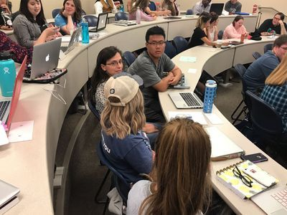
Academics

Slide 16
Which classes do students take if they are receiving support from inclusive services?
Classes from college course catalog
Selected based on area of interest
Taken with peers without disabilities
Earn credits

Slide 17
What degree do students get if they access inclusive services?
Comprehensive Higher Education Certificate
Concentration in area of interest
Credits do not count towards an Associate’s or Bachelor’s degree
Exception: At ACC students can pursue an Associate’s degree and receive support from Elevate

Slide 18
Tell me more about the Comprehensive Higher Education certificate. What is it exactly?
Awarded by the institute of higher education
36-72 credit hours, depending on the school
Three classes/semester
2 traditional classes, 1 specialized class
Career experience

Slide 19
Do students receive grades?
Yes
Graded

Slide 20
How do professors know how to modify classes appropriately if they’ve never taught students with ID before?
Professors receive support from the inclusive service office staff

Slide 21
Career

Slide 22
Will I have a job on campus? What will that look like? What are the supports like?
Year 1: Career exploration
Year 2: On campus employment
Years 3 & 4: Internships and work experiences off campus
Summer employment encouraged

Slide 23
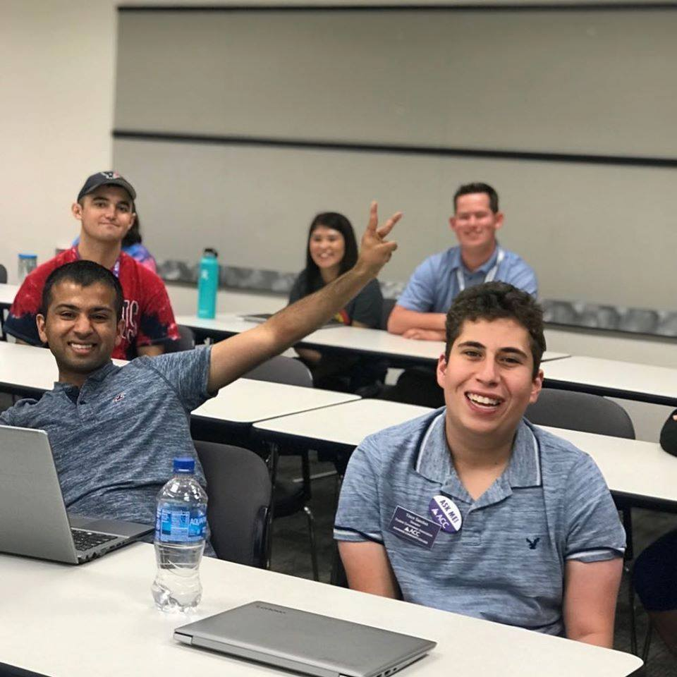
Social

Slide 24
What is a peer mentor?
Key part of inclusive higher education
Other college students
Provide academic support, social support, and encourage independence

Slide 25
When it comes to support, what is expected of parents?
Shifting from advocate to advisor
Encourage students to advocate for their own needs

Slide 26
Housing

Slide 27
If I choose to live on campus, what sort of support will I receive?
UCCS
Apartments
Medicaid waivers for independent living supports
UNC
Year 1 & 2: Residence halls
Years 3 & 4: Students choose from wide range of options
ACC
No housing associated with the college

Slide 28
Do parents need to live near campus?
No
Students come from all over the state and even out of state
UNC specific: Students need to be their own guardian

Slide 29
Does someone check-in on students during free time or unstructured time or weekends? What happens outside of regular 9-5 hours?
24/7 care is not provided
Peer mentors are one resource
Campus police, mental health center, residence life staff, etc.

Slide 30
What if I have a particular medical need, mobility need, or something else that has me worried about my ability to live away from home?
Meet with the inclusive staff on campus
Reach out to IN! with additional barriers

Slide 31
Cost

Slide 32
What are the costs associated with college?
Tuition
Inclusive service fee
Room & board (if applicable)
All costs paid to the college
Reminder: IN! does not provide direct services and does not receive any funds from students
Look at each school website for specific costs
Reach out to the school to be connected to the financial aid office

Slide 33
Are there any options to help pay for college?
Comprehensive Transition Program (CTP) designation allows for access to financial aid
Colorado CTPs: UNC, ACC, UCCS
Work study, grants, but not loans
Disability specific: Division of Vocational Rehabilitation, Social Security Income, ABLE accounts
More in module 5

Slide 34
College Search

Slide 35
Campus Visits
Help students envision themselves on campus
Is anyone in your district organizing a college visit?
Counselors, teachers, administrators
Include students with ID with other students

Slide 36
At School Options
Postsecondary high school counselors
Visits with college specific admission counselors
Others who are less familiar with inclusive services can still provide students an overview of what campus is like

Slide 37
College Awareness Resources
National Association for College Admission Counseling
Think College
National coordinating center for inclusive higher education
Thinkcollege.net
IN!
Colorado specific
Inclusivehighered.org

Slide 38
Other Ideas
Contact the college admission department for a special class visit and presentation by inclusive services
Host a college student panel
Offer a College & Career exploration class as part of the district transition program
Lesson plans that include college content

Slide 39
Multiple Identities
First generation
English as a second language
Black, Indigenous, and other People of Color
LGBTQ+

Slide 40
Conclusion

Slide 41
Next Steps
Next module: Preparing All Students for College
Module credit: Google Form linked in video description

